Slide 1
The basic reproduction number for non-randomly mixing populations
Jeehyun Lee
Mathematics / Computational Science & Engineering
Yonsei University

Slide 2
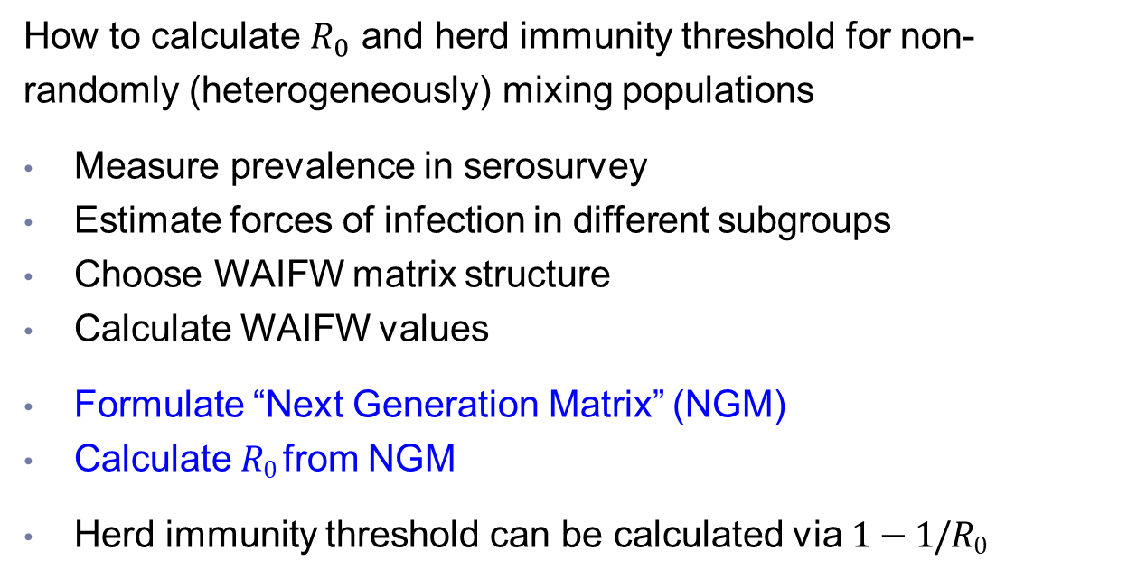
Objectives
How to calculate $R_{0}$ and herd immunity threshold for non-randomly (heterogeneously) mixing populations
Measure prevalence in serosurvey
Estimate forces of infection in different subgroups
Choose WAIFW matrix structure
Calculate WAIFW values
Formulate “Next Generation Matrix” (NGM)
Calculate $R0$ from NGM
Herd immunity threshold can be calculated via $1−1/R0$
Notes:
During the last session you saw how the effect of vaccination on reducing transmission in a
population depended greatly on assumptions about contact between individuals. This
suggests that the herd immunity threshold and therefore R0 must depend on the amount of
contact between different subgroups in the population. In this session we illustrate how R0
can be calculated by taking account of contact patterns between different population
subgroups.

Slide 3
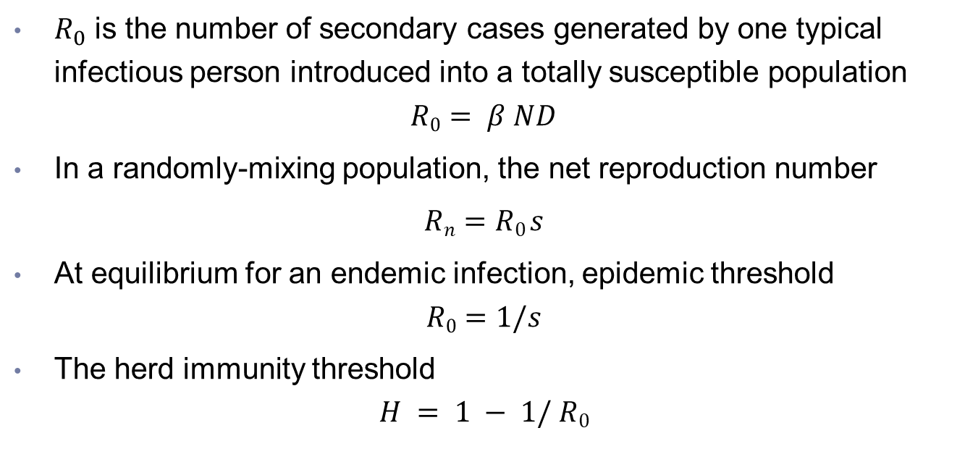
Reproduction number & Threshold
$R_{0}$ is the number of secondary cases generated by one typical infectious person introduced into a totally susceptible population
$$R0 = β N D$$
In a randomly-mixing population, the net reproduction number
$Rn=R0 s$
At equilibrium for an endemic infection, epidemic threshold
$$R0=1/s$$
The herd immunity threshold
$$H = 1 − 1/ R0$$

Slide 4
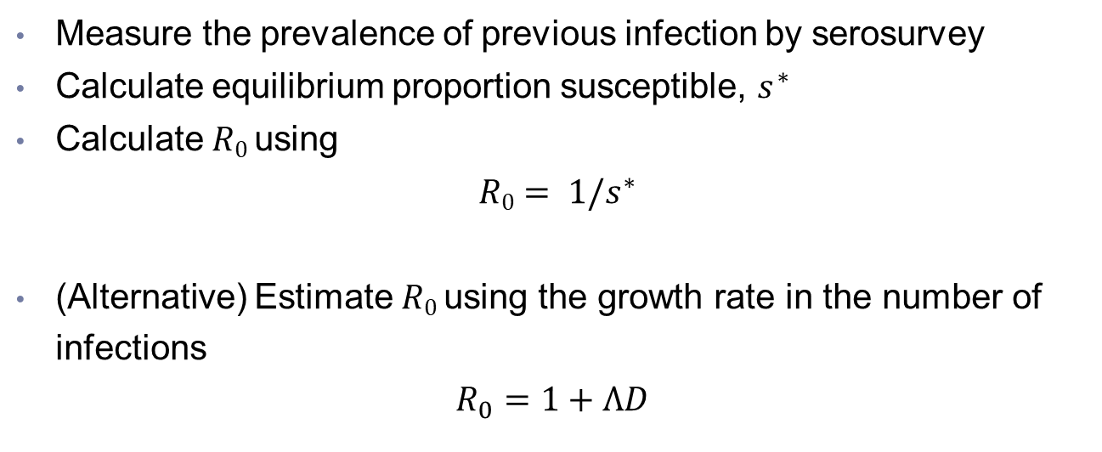
Calculating $R_{0}$ in a randomly mixing population
Measure the prevalence of previous infection by serosurvey
Calculate equilibrium proportion susceptible, $s^{∗}$
Calculate $R0$ using
$R0= 1/s^{∗}$
(Alternative) Estimate $R0$ using the growth rate in the number of infections
$$R_{0}=1+ΛD$$

Slide 5
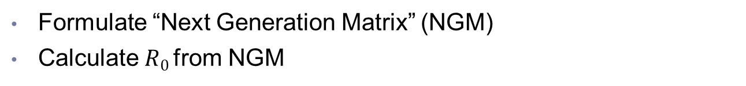
Calculating $R_{0}$ in a non-randomly mixing population
Measure prevalence in serosurvey
Estimate forces of infection in different subgroups (e.g. age strata)
Choose WAIFW matrix structure
Calculate values of WAIFW matrix
Formulate “Next Generation Matrix” (NGM)
Calculate $R0$ from NGM

Slide 6


Next Generation Matrix - Example
Number of secondary infections generated by one infectious person introduced into totally susceptible population depends on subgroup to which index case belongs
Y
O
Y
O
y o
y o
Population A
y
o
$$\left[\begin{matrix}4 & 1 \\ 2 & 2\end{matrix}\right]$$
Population B
y
o
$$\left[\begin{matrix}1 & 3 \\ 3 & 1\end{matrix}\right]$$

Slide 7



Next Generation Matrix
$Rij$ the number of secondary infections in group $i$ produced by an infectious person in group $j$ in a totally susceptible population
The Next Generation Matrix has these values as its entries, where $Rij$ is the value in the $i$^{th} row and the $j$^{th} column
$$Rij =βij Ni D$$
$Ni$ is the size of group $i$
$D$ is duration of infectiousness

Slide 8
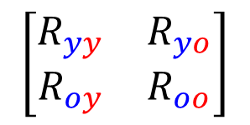
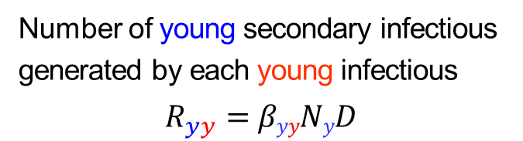
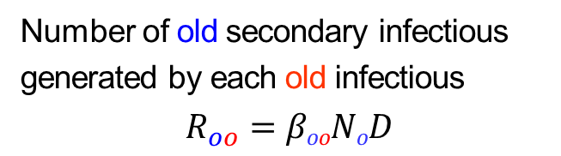
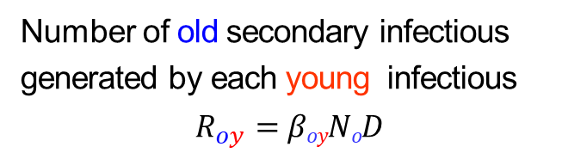
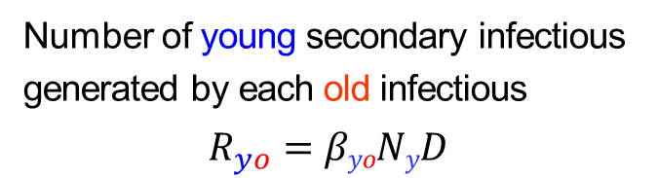
Next Generation Matrix
For populations stratified into young and old individuals, NGM is :
Number of young secondary infectious generated by each young infectious
$$R_{yy}=βyyNyD$$
Number of young secondary infectious generated by each old infectious
$$R_{yo}=βyoNyD$$
$$\left[\begin{matrix}R_{yy} & R_{yo} \\ R_{oy} & R_{oo}\end{matrix}\right]$$
Number of old secondary infectious generated by each young infectious
$$R_{oy}=βoyNoD$$
Number of old secondary infectious generated by each old infectious
$$R_{oo}=βooNoD$$

Slide 9
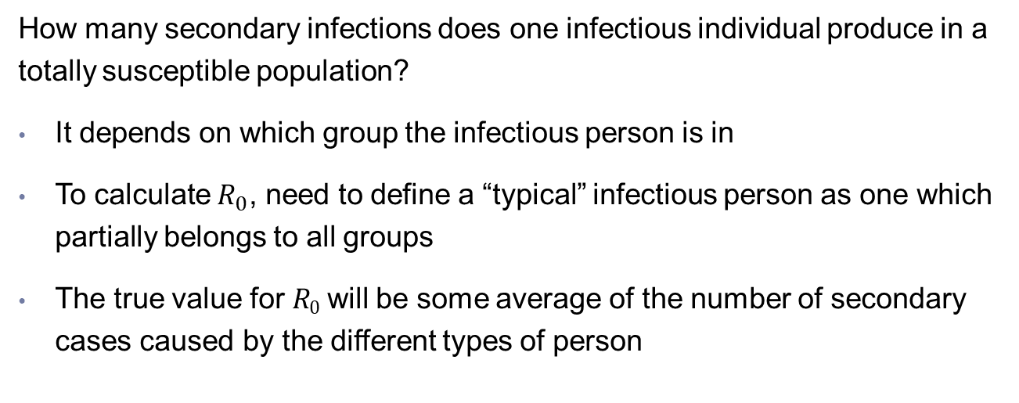


Calculating $R_{0}$ from the Next Generation Matrix
How many secondary infections does one infectious individual produce in a totally susceptible population?
It depends on which group the infectious person is in
To calculate $R_{0}$, need to define a “typical” infectious person as one which partially belongs to all groups
The true value for $R0$ will be some average of the number of secondary cases caused by the different types of person
y o
y o
y
o
$$\left[\begin{matrix}4 & 1 \\ 2 & 2\end{matrix}\right]$$
y
o
$$\left[\begin{matrix}1 & 3 \\ 3 & 1\end{matrix}\right]$$
Population A
Population B

Slide 10
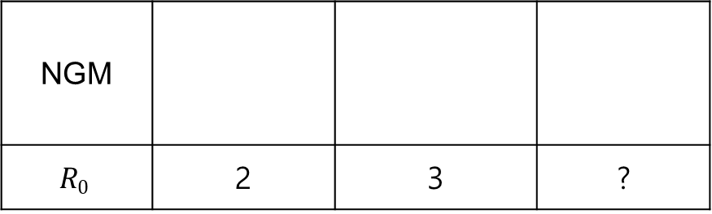
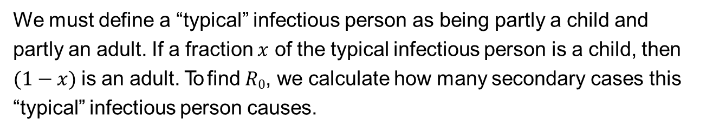



Calculating $R_{0}$ from the Next Generation Matrix
NGM
$$R0$$ | 2 | 3 | ?
y o
y o
y o
y
o
$$\left[\begin{matrix}1 & 1 \\ 1 & 1\end{matrix}\right]$$
y
o
$$\left[\begin{matrix}2 & 1 \\ 1 & 2\end{matrix}\right]$$
y
o
$$\left[\begin{matrix}1 & 1 \\ 1 & 4\end{matrix}\right]$$
We must define a “typical” infectious person as being partly a child and partly an adult. If a fraction $x$ of the typical infectious person is a child, then $(1−x)$is an adult. To find $R0$, we calculate how many secondary cases this “typical” infectious person causes.

Slide 11
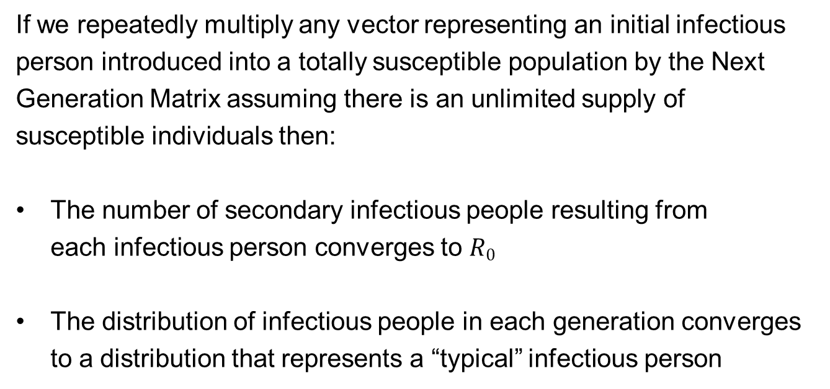
Calculating $R_{0}$ from the Next Generation Matrix
If we repeatedly multiply any vector representing an initial infectious person introduced into a totally susceptible population by the Next Generation Matrix assuming there is an unlimited supply of susceptible individuals then:
The number of secondary infectious people resulting from each infectious person converges to $R0$
The distribution of infectious people in each generation converges to a distribution that represents a “typical” infectious person

Slide 12

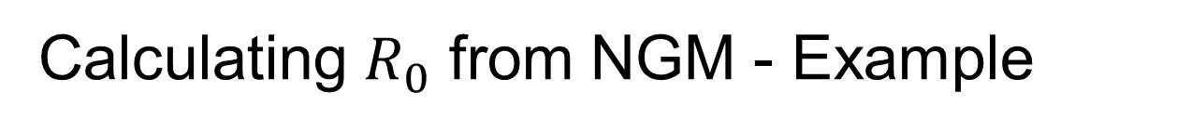


Calculating $R_{0}$ from NGM - Example
generation | children | adults | total G_{k} | G_{k}/G_{k-1}
0 | 1 | 0 | 1
1 | 1 | 1 | 2 | 2
2 | 2 | 5 | 7 | 3.5
3 | 7 | 22 | 29 | 4.1
4~7 | ⋯ | ⋯ | ⋯ | ⋯
8 | 9866 | 32585 | 42451 | 4.3
9 | 42451 | 140206 | 182657 | 4.3
generation 1
generation 2
generation 3
$$\left[\begin{matrix}1 & 1 \\ 1 & 4\end{matrix}\right]\left[\begin{matrix}1 \\ 0\end{matrix}\right]=\left[\begin{matrix}1 \\ 1\end{matrix}\right]$$
$$\left[\begin{matrix}1 & 1 \\ 1 & 4\end{matrix}\right]\left[\begin{matrix}1 \\ 1\end{matrix}\right]=\left[\begin{matrix}2 \\ 5\end{matrix}\right]$$
$$\left[\begin{matrix}1 & 1 \\ 1 & 4\end{matrix}\right]\left[\begin{matrix}2 \\ 5\end{matrix}\right]=\left[\begin{matrix}7 \\ 22\end{matrix}\right]$$

Slide 13
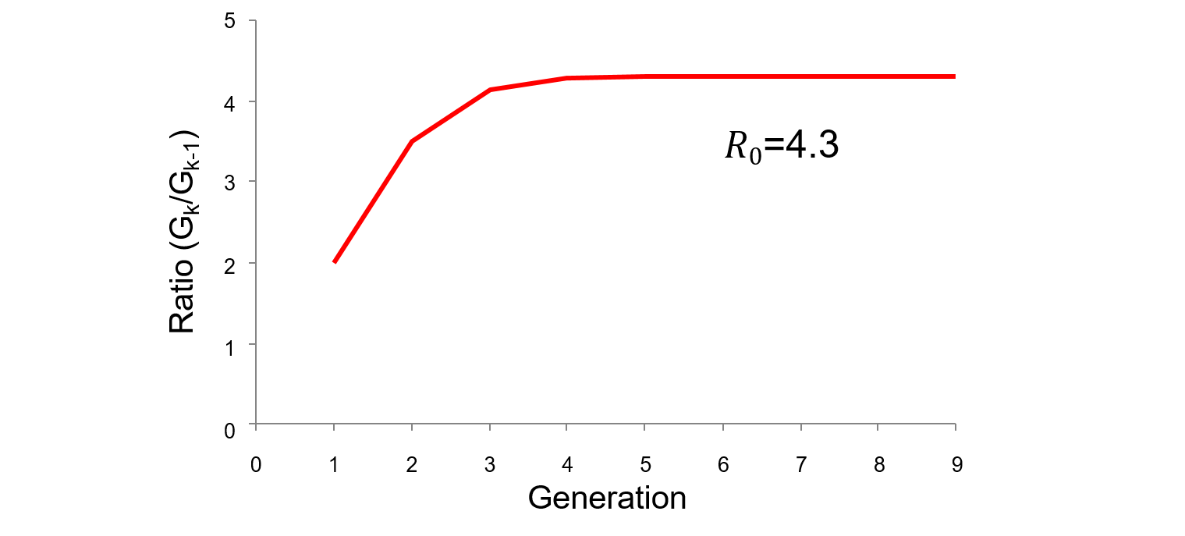
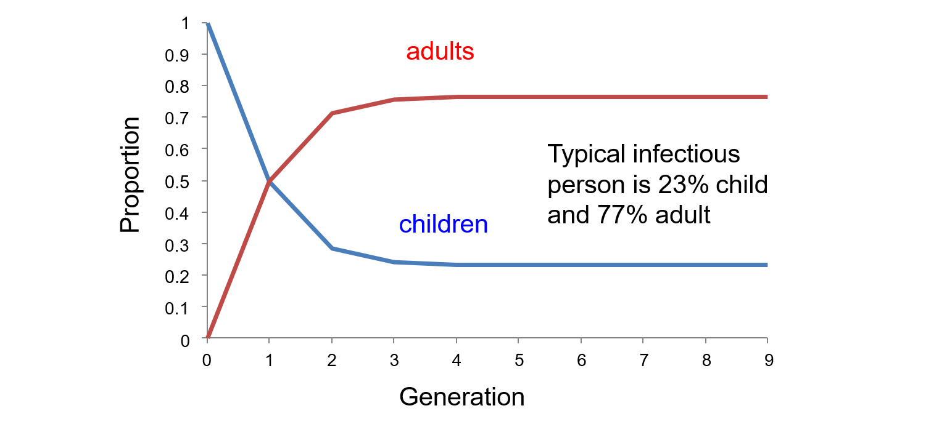
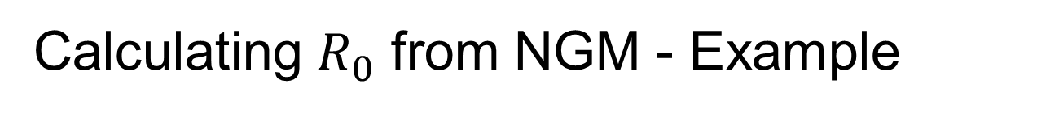
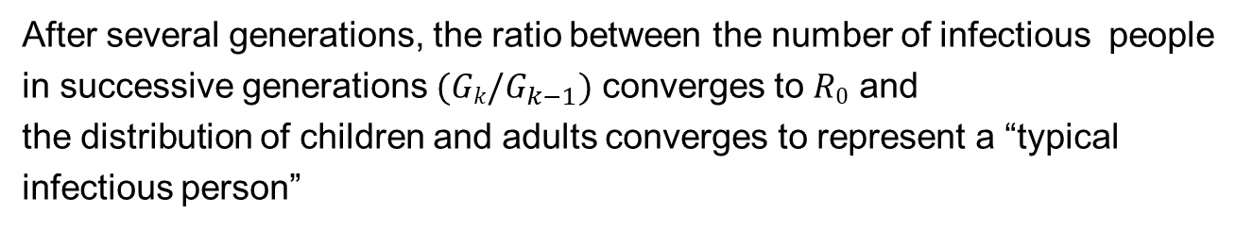
Calculating $R_{0}$ from NGM - Example
After several generations, the ratio between the number of infectious people in successive generations $(Gk/G_{k−1})$ converges to $R0$ and
the distribution of children and adults converges to represent a “typical infectious person”

Slide 14
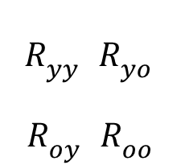
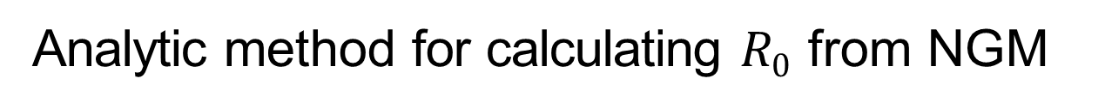
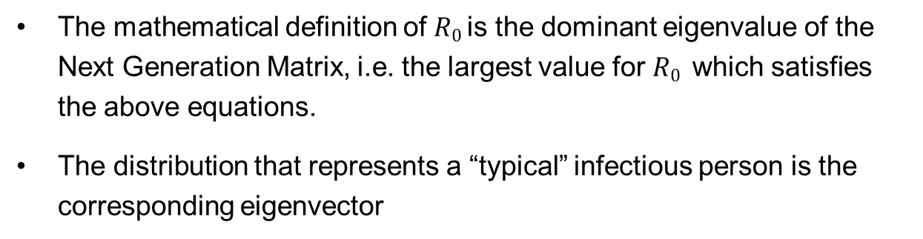
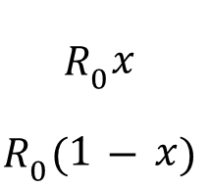

Analytic method for calculating $R0$ from NGM
$$R_{yy} R_{yo}$$
$R_{oy} R_{oo}$
$$x$$
$$1−x$$
$$R_{0}x$$
$$R_{0}(1−x)$$
=
Next generation matrix
The mathematical definition of $R0$ is the dominant eigenvalue of the Next Generation Matrix, i.e. the largest value for $R0$ which satisfies the above equations.
The distribution that represents a “typical” infectious person is the corresponding eigenvector

Slide 15




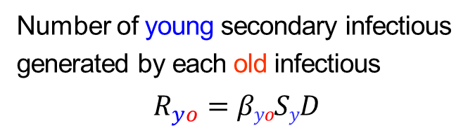
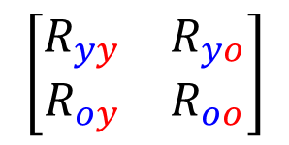
Next Generation Matrix for $Rn$
The same approach can be used to calculate the net reproduction number for a population in which some individuals are immune, where NGM is :
Number of young secondary infectious generated by each young infectious
$$R_{yy}=βyySyD$$
Number of young secondary infectious generated by each old infectious
$$R_{yo}=βyoSyD$$
$$\left[\begin{matrix}R_{yy} & R_{yo} \\ R_{oy} & R_{oo}\end{matrix}\right]$$
Number of old secondary infectious generated by each young infectious
$$R_{oy}=βoySoD$$
Number of old secondary infectious generated by each old infectious
$$R_{oo}=βooSoD$$

